Slide 1
“Effective social justice advocacy:
a theory of change framework
for assessing progress”
Barbara Klugman
RHM 19 (38) 2011
– reflections on the terrain
since its publication in 2011

Slide 2
Shift in advocacy groups’ thinking on evaluating advocacy, from
“advocacy takes place in complex systems
… it’s impossible to evaluate”
to
“evaluation is key to strategising ….
it supports emergent learning”

Slide 3
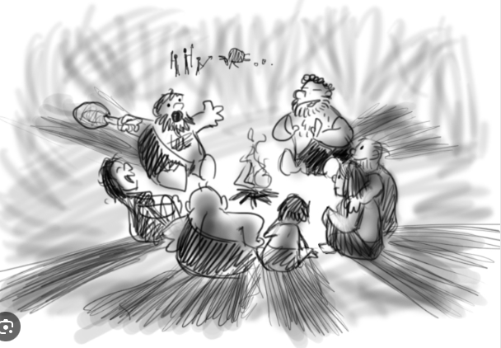
Participation as the essential dimension of learning – for evaluation to be useful
“putting agency and meaningfulness at the core of ‘social learning spaces’"
Wenger-Trayner E & B (2020)
https://www.animatorisland.com/story-101-why-do-we-tell-stories/

Slide 4
Increased use of outcomes-oriented evaluation approaches and attention to causal pathways
“When done well, causal analysis can lift up and leverage the power of stories, lived experiences, and multiple ways of knowing.”
Lynn, Stachowiak and Coffman (2021)

Slide 5
Evaluating if and how well advocacy processes & outcomes uphold social justice principles
Interest in equity-focused evaluation; feminist evaluation
(Equitable Evaluation Initiative, Dossa et al 2023, Podems 2018)
Guidance in articulating principles in ways that are evaluable –
(Patton 2018)

Slide 6
Shifts in funders’ approaches
Shifts in funders’ approaches to evaluation
Towards trust-based philanthropy
Fostering local resourcing, building of agency and trust – supporting documentation and field learning
“We want our process to serve as collective spaces for shared learning that engage in a relational approach based on trust and mindfulness.”
Kamala Chandrakirana,
Indonesia for Humanity (2022)

Slide 7
Shifts in funders’ approaches to evaluation
Moving away from pre-set indicators and a focus on what groups did (outputs) or guestimates of influence (# of beneficiaries)
Towards learning from what changes groups (alone or with others) actually influenced (or did not influence) and why this is
Core funding enables institutionalisation of emergent learning processes

Slide 8
Thank you!
bklugman@mweb.co.za
+27720999644
Cape Town
BARBARA KLUGMAN CONCEPTS

