Slide 1
Is there an alternative to grant-funding for sexual and reproductive health advocacy? A survey of the income base of AmplifyChange grantees
Sexual and Reproductive Health Matters
September 2023

Slide 2
SRHR Civil society relies heavily on international grants

Slide 4
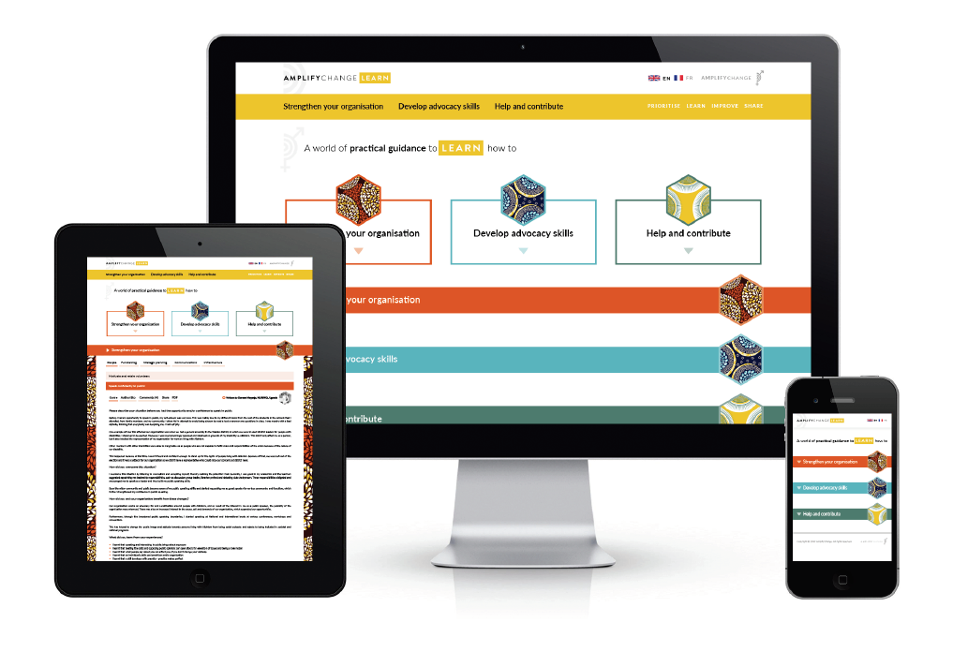
Visit amplifychangelearn.org Read How To Guides written by grantee partners about their experience of finding alternative income to grants

